Slide 1


Speed Dating
Data Analysis Project
Sielecki Radu Bogdan
Luta Mihai Alexandru

Slide 2
Introduction & Project Overview
Project Goal: Analyze a speed dating dataset to uncover patterns, predict match outcomes, and visualize key insights.
Tools Used:
Jupyter Notebook (Python for data preprocessing, feature engineering, and model training)
Power BI (for interactive data visualization and reporting)

Slide 3
Data Preprocessing (Jupyter Notebook)
Initial Data Loading
Handling String Data
Categorize professional fields - Grouped diverse field entries into broader, more manageable categories, such as:
categories = { "Health & Medical Sciences": ["medicine", "medical", "health", ...], "Business, Finance & Management": ["business", "mba", "finance", ...], etc. }
Feature transformations(Ex:Converted samerace to integer type,Calculated age_diff)
Column Dropping(Ex: has_null, wave etc.)
Output: speed_dating_cleaned.csv

Slide 4
Feature Engineering & Scaling (Jupyter Notebook)
Handling Missing Values: SimpleImputer(strategy='median') for numerical columns.
Feature Scaling: StandardScaler() to numerical features to normalize their range.
One-Hot Encoding
Data Splitting: Split the dataset into training and testing sets for model evaluation (test_size=0.2, random_state=42)

Slide 5
Model Training & Evaluation (Jupyter Notebook)
Objective: Predict the match outcome.
Classifiers Tested:
- Logistic Regression (logreg)
- Support Vector Classifier (svc)
- K-Nearest Neighbors (knn)
- Random Forest Classifier (rf)
Accuracy Results:
logreg: 0.8478
svc: 0.8526
knn: 0.8239
random forest: 0.8562 (Highest Accuracy)

Slide 6
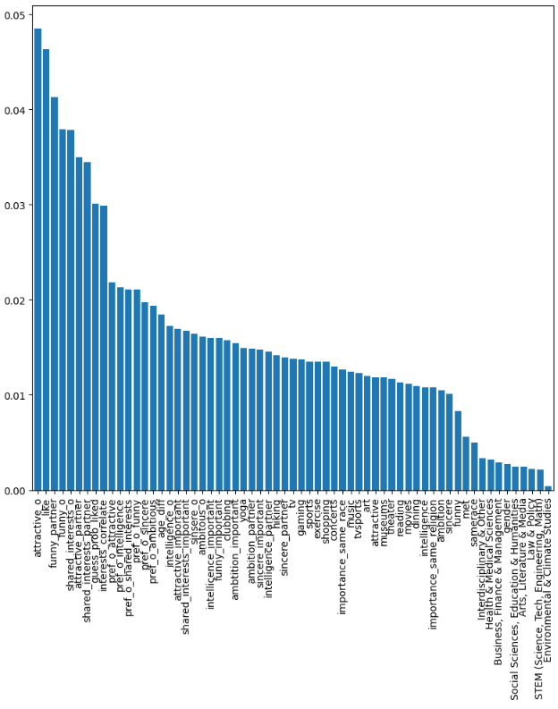
Feature Importance (Jupyter Notebook)
Method: Used the Random Forest Classifier to identify the most influential features for predicting a match.
Key Insights:
- Attractiveness and being funny
are the most important features. Shared
Interest came in the 3rd place.

Slide 7
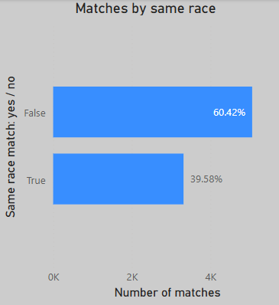
Power BI Report: Race Analysis(I)
Matches by Same Race:
39.58% of matches occurred between individuals of the same race.
60.42% of matches occurred between individuals of different races.

Slide 8
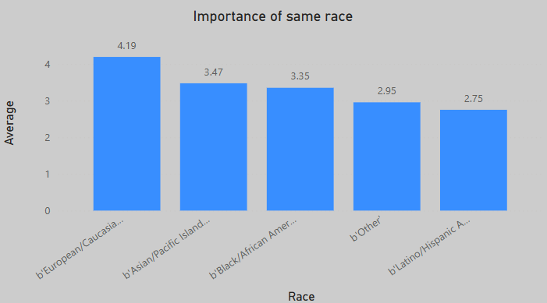
Power BI Report: Race Analysis(II)
Importance of Same Race: "European/Caucasian" participants, on average, placed the highest importance on same-race matching (4.19).

Slide 9
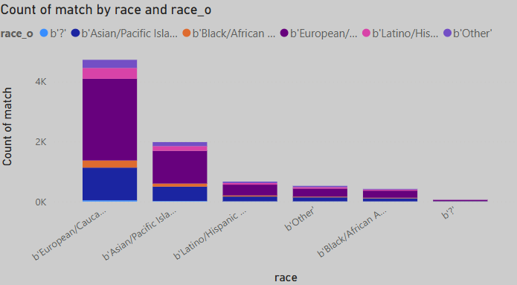
Power BI Report: Race Analysis(III)
Match count by race & race of dating partner:
European/Caucasian-American is the largest group
European and Asian are the most popular races that are picked by a person from another race

Slide 10
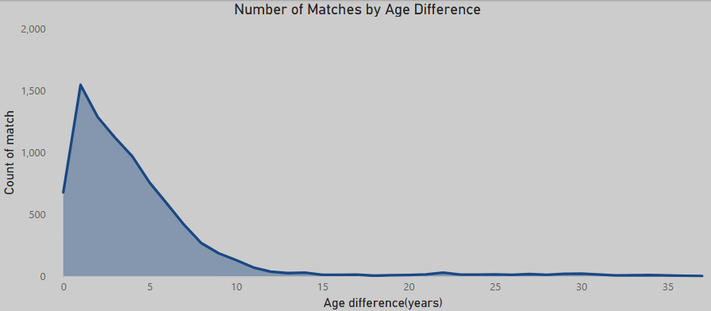
Power BI Report: Age & Character Analysis
Matches by Age Difference:
- The highest number of matches occurred when the age difference between partners was small, peaking around 0-5 years.
- As the age difference increases,
matches chance significantly decreases.

Slide 11
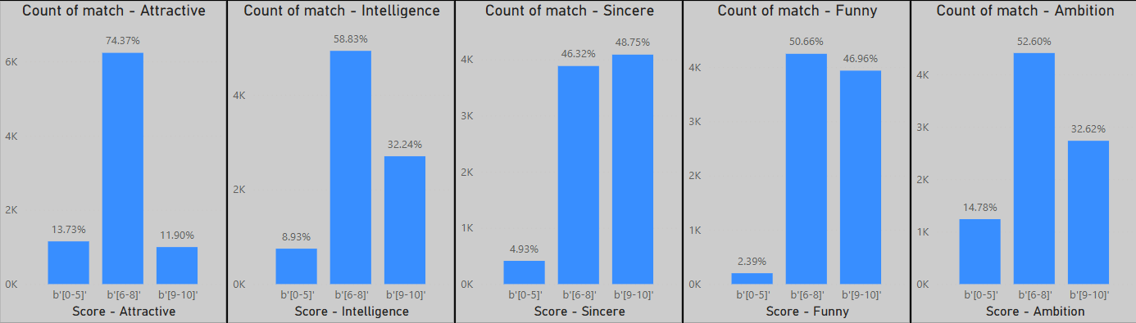
Power BI Report: Age & Character Analysis(II)
Impact of Character Traits on Matches:
- Attractiveness: Highest number of matches for higher attractiveness scores (74.37% for b'6-8' score range).
- Intelligence, Sincerity, Funny, Ambition: These traits also show a positive correlation with match count, with higher scores generally leading to more matches.

Slide 12
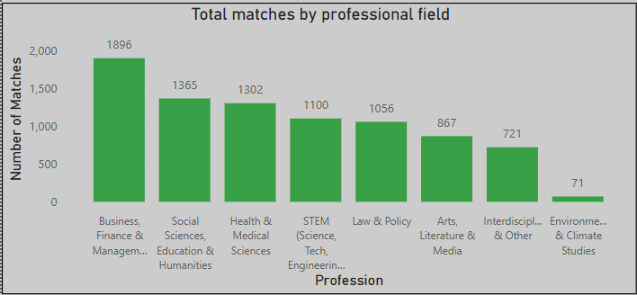
Power BI Report: Professional Field Analysis(I)
Total matches by professional field:
- Business, Finance & Management had the highest number of matches (1896).
- Social Sciences, Education & Humanities and Health & Medical Sciences also showed high match counts.
- Environmental& Climate studies is the least popular professional field.

Slide 13
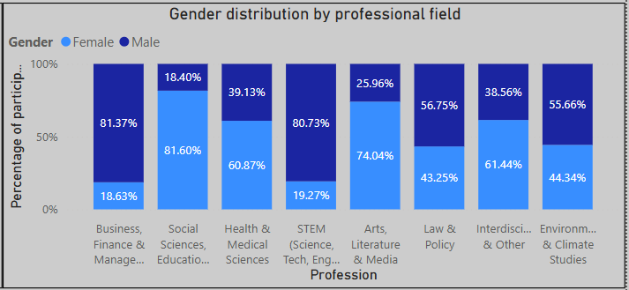
Power BI Report: Professional Field Analysis(II)
Gender distribution by professional field:
- Significant gender imbalances exist in some fields (e.g., Business, Finance & Management with 81.37% male and Social Sciences, Education & Humanities with 81,60% for females).

Slide 14
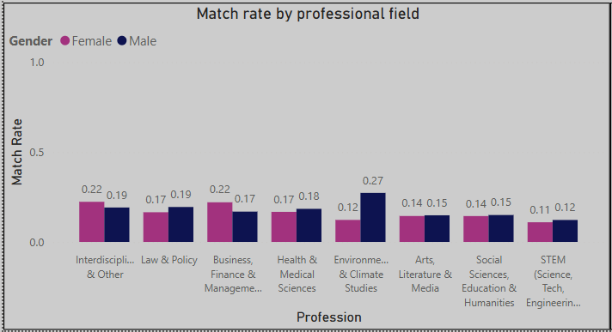
Power BI Report: Professional Field Analysis(III)
Match Rate by Professional Field:
- "Interdisciplinary & Other" and "Law & Policy" showed the highest match rates for both genders.
- For males, Environmental & Climate studies has the highest match rate, while for females Interdisciplinary & Other and Law & Policy are tied for the highest match rate).

Slide 15
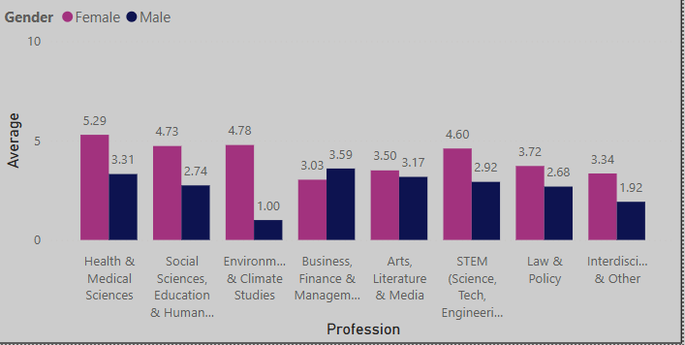
Power BI Report: Professional Field Analysis(IV)
Importance of having the same religion by professional field:
- Surprisingly, "Health & Medical Sciences" participants, on average, placed higher importance on same-religion matches.
- Females seem to care more about having the same religion as their partner.

Slide 16
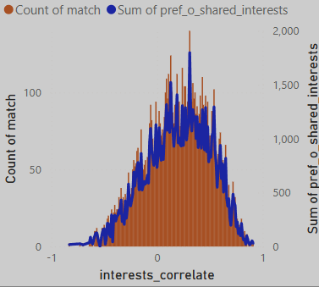
Power BI Report: Hobbies Analysis – Overview(I)
Interests Correlation and Matches:
- A strong positive correlation exists between shared interests and the number of matches.

Slide 17
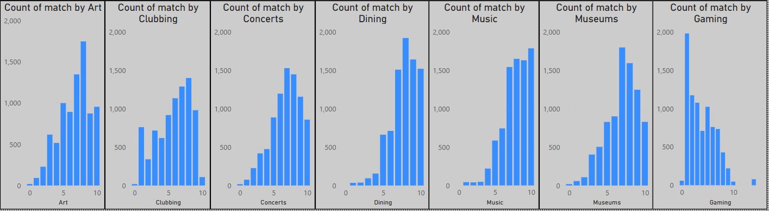
Power BI Report: Hobbies Analysis – Overview(II)
Match count by individual hobbies:
- For most hobbies (e.g., Yoga, Theater, Reading, Movies, Art, Clubbing), higher engagement scores generally lead to more matches. The only exception seems to be Gaming, where higher scores lead to less matches.

Slide 18
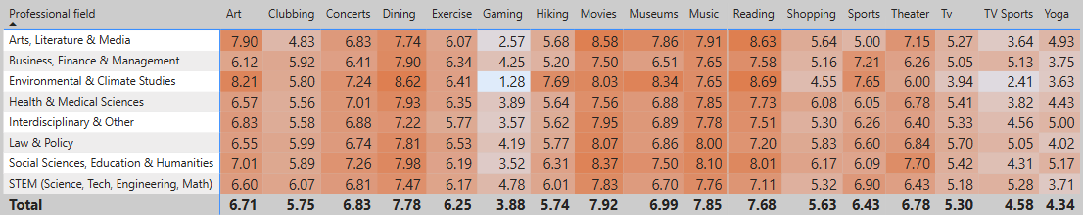
Power BI Report: Hobbies Analysis(III)
Average preference of hobbies by professional field:
- Preferences for hobbies vary significantly across professional fields. For instance, "Arts, Literature & Media" shows high preference for "Reading" (8.63), while "Environmental & Climate Studies" prefers "Hiking" (8.69).

Slide 19
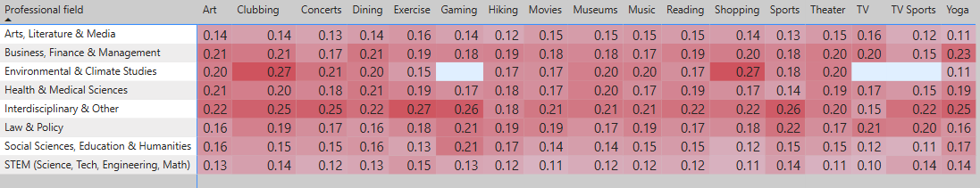
Power BI Report: Hobbies Analysis(IV)
Match rate by hobby:
- People from Environmental & Climate studies with a high interest in clubbing seems to have one of the highest match rate.
- The preferred hobbies of people from Arts, Literature & Media and STEM seem to not matter that much in their chance to get a match.

Slide 20
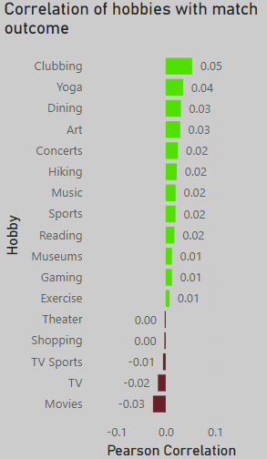
Power BI Report: Hobbies Analysis(V)
Overall Correlation of Hobbies with Match Outcome:
- Highlights that hobbies like Clubbing, Yoga, and Dining have a positive impact on match outcomes, while TV and Movies have a negative impact.

Slide 21
Conclusion & Key Takeaways
Key Factors for Matches:
Age Difference: Smaller age differences are highly correlated with matches.
Race: While a notable percentage of matches occur within the same race, a larger percentage occur across different races.
Traits: Attractiveness is a significant factor in match likelihood.
Shared Interests: High correlation in interests strongly increases the chance of a match.
Professional Fields: Certain fields (e.g., Business, Social Sciences, Health) have higher overall match counts.
Hobbies: Engaging in active/social hobbies (Clubbing, Yoga, Dining) positively correlates with matches, while passive hobbies (TV, Movies) show a negative correlation.

